Slide 1
Molecular Biology Techniques
Derrick Liang
February 22, 2020
Notes:
See Albert’s Chapter 8, Lehninger’s Chapter 9, Weaver Chapter 4-5
Below were some of my notes in organizing this lecture; i’ll leave them here in case someone finds them useful :)
Questions:
If the site is GA_T__, what is the full sequence of the site?
If the sequence is ANANA?
If the sequence is ANANA, what is the expected number found in something (N is G or C), when the proportion of AT is 40%?
https://biology.stackexchange.com/questions/9913/why-do-type-ii-restriction-endonucleases-cleave-at-palindromic-sequences
Plasmids can’t have same ori, since they would be regulated the same way and compete for growth (one would outcompete the other). BACs are basically just plasmids but with better ori, so that it maintains a low copy number. Also, BACs have the par gene, derived from F plasmids, which ensures the even distribution of BACs into the two daughter cells despite low copy number
(Tetracycline blocks aminoacyl tRNA attachment to ribosome; it binds to ribosome
ampicillin is like penicillin!
Chloramphenicol inhibits peptidyl transferase action)
Note that YACs are eukaryotic! They need centromere, and telomeres, so we can cleverly add those into the circular structure. But then they can help for eukaryotic proteins! Bigger YACs are stabler
List out diffs between bacterial and eukaryotic transcription/translation:
(-35 Pribnow and -10 vs TATA, Shine-Dalgarno vs Kozak, sigma factor vs general transcription factors, terminator vs polyadenylation sequence? )
Proteolysis, covalent modification (glycosylation, lipid addition), intrinsically disordered?
Once we’ve applied a restriction digest to insert the protein
we can then use PCR cleverly to see if it was properly inserted.
PCR Problem ideas:
Give a function for how many of the modified added restriction sequences there’ll be after x steps
Less cleverly, we could use DNA sequencing methods to check it.
Let’s also go on a slight tangent to see how those work
Going into analyzing patterns more, we could also use
With these expression vectors, we get tons of proteins
Separate above into expressing a specific gene of interest. This is more of a practical focus.
Once we’ve gotten our protein expressed and folded properly, we move on to explore all proteins
————————————————————————
Separate into overall analyzing and understanding of all gene functions
We can use the DNA libraries to now categorize tons of different genes
cDNA and DNA libraries to analyze the expression
Specifically, rt-qPCR can also be used to quantify gene expression in cells (qPCR could quantify the amount in our extraction perhaps)
Note the mechanism of fluorescence (quenchers!)
We can also purify DNA/RNA using minipreps which pipe into the Phenol-Chloroform extraction technique
At this point, mention that low pH degrades both of them, but high pH only degrades RNA (alkaline hydrolysis)
Now that we’ve got the genes we want, how do we get modified proteins?
SITE-DIRECTED MUTAGENESIS
http://2014.igem.org/wiki/images/b/b5/Wageningen_UR_protocols_Site_Directed_Mutagenesis.pdf
With those mutagenized proteins, how to we purify/quantify them?
We could also use microarrays to analyze the overall qualitative pattern of gene expression in cells, and can use green + red dyes to see a visual overlap/distinction between the patterns of two cell/tissue groups.
Sort out short tandem repeats, microsatellites, RFLPs
Open Reading Frame calculations?

Slide 2
Cloning/expressing a gene of interest

Slide 3
Recombinant DNA Technology
Restriction enzymes can consistently cleave at specific sites
Ligation/joining
Replication
Hybridization allows for sensitive and accurate selection
Denaturation and renaturation
DNA can be synthesized
DNA can be sequenced

Slide 4
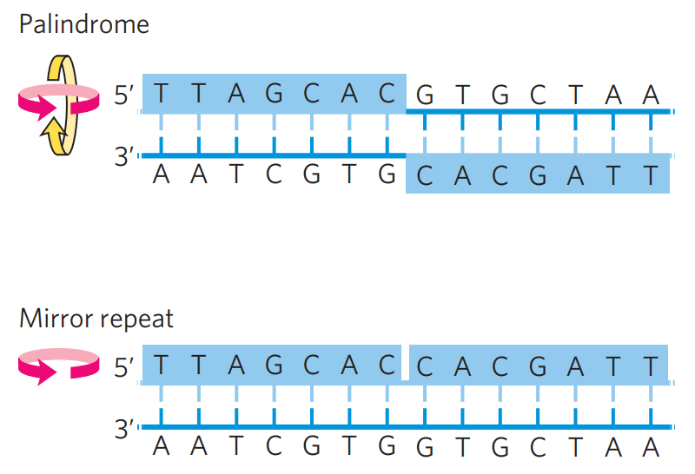
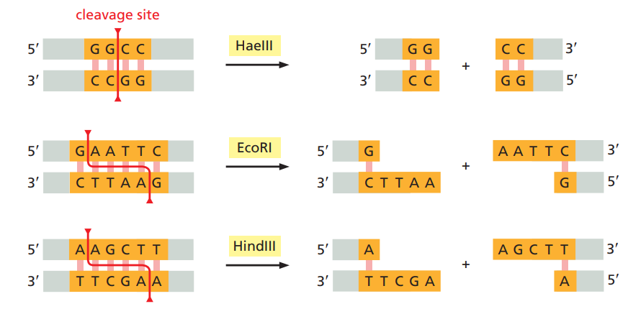
Restriction Enzymes
Bacteria-derived (ex. EcoRI)
Defense against viruses, methylation protects themselves
Exonuclease vs. endonuclease
Type II endonucleases don’t need ATP
Palindromic recognition sites (usually)
Blunt ends vs. sticky ends
Notes:
Type 1 and 3 endonucleases use ATP
Palindromic means 5’-3’ read on each strand is the same! (So, 180º rotational symmetry)
It makes some sense why they are palindromic (not always, but mostly)
Dimerization is a common evolutionary adaptation to easily double the affinity or efficiency of a reaction/binding
https://biology.stackexchange.com/questions/9913/why-do-type-ii-restriction-endonucleases-cleave-at-palindromic-sequences

Slide 5
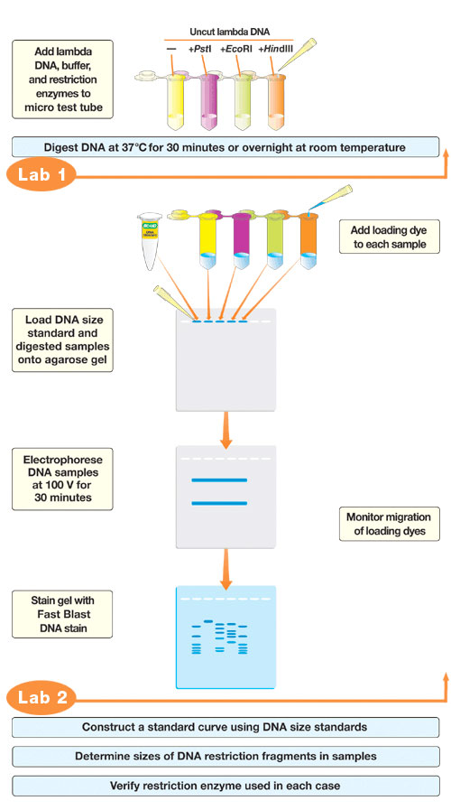
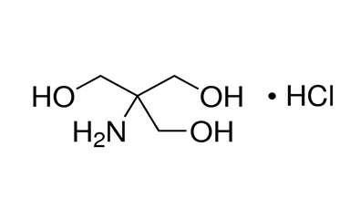
Restriction Digest
Note that they are still enzymes
Conditions:
NaCl adds ionic strength
Mg²⁺ is a cofactor
Tris-HCl to buffer the pH around 7.2-8.5
Incubation at 37ºC, since bacteria normally grow at that temperature
Longer incubation ⇒ more complete digest
Notes:
https://blog.addgene.org/plasmids-101-restriction-cloning

Slide 6
Practice!
If the site is 5’ GA_T_ _ 3’ (length 6), what is the full sequence of the site?
If the sequence is ANGN, what is the expected number found in a 10⁴ long sequence (N is G or C)? Assume each nucleotide is equally likely.
What if the GC content is 60%?
Notes:
5’ GAATTC 3’
3’ CTTAAG 5’
10⁴/(4²2²) = 156.25
10⁴ * (0.2*0.3*0.6*0.6) = 216

Slide 7
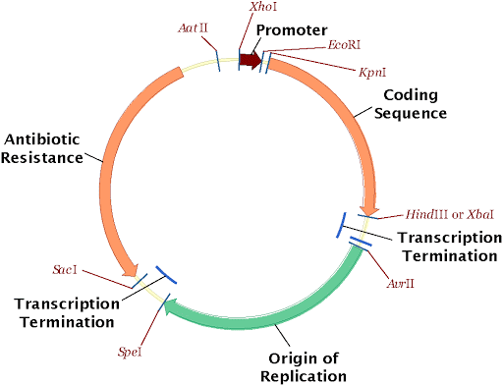
Features of Cloning Vectors
Polylinker region or multiple cloning site (MCS)
Selectable marker - control growth
Antibiotic resistance genes
Screenable marker
GFP, beta-galactosidase
Origin of replication (ori)
Small size
Notes:
Selectable markers relate to actual growth
Positive selection = allows for growth
Negative selection = fails to grow
Example: if we have two resistance genes, we can use the first to just determine if a plasmid was uptaken at all. Then, we can transfer it to another plate which has the second antibiotic. If it was inserted properly, then it will be selected against since the second resistance gene is disrupted. This is quite strong evidence that it was properly inserted.
Screenable markers are those that can show color or fluorescence in specific conditions, but don’t harm the cell

Slide 8
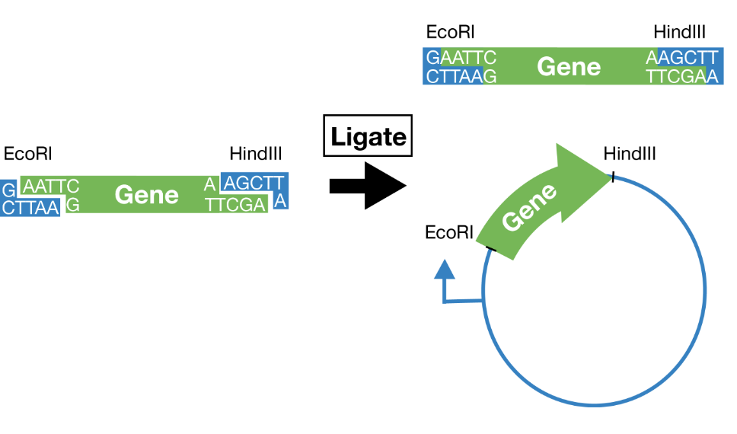
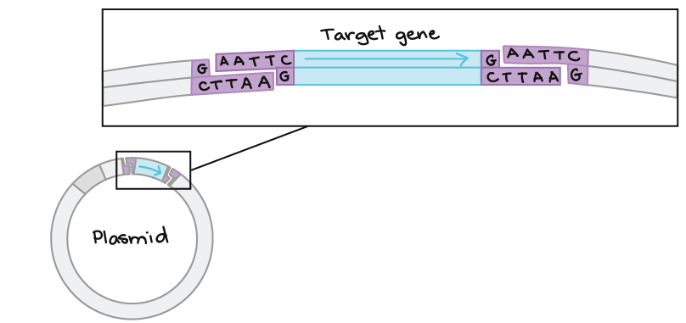
Subtle Point About Orientation
These two restriction digests are not the same
What’s special about the left one?
Notes:
Two restriction enzymes helps FORCE the orientation correctly, whereas just one could lead to inverted inserts!
https://blog.addgene.org/plasmids-101-restriction-cloning

Slide 9
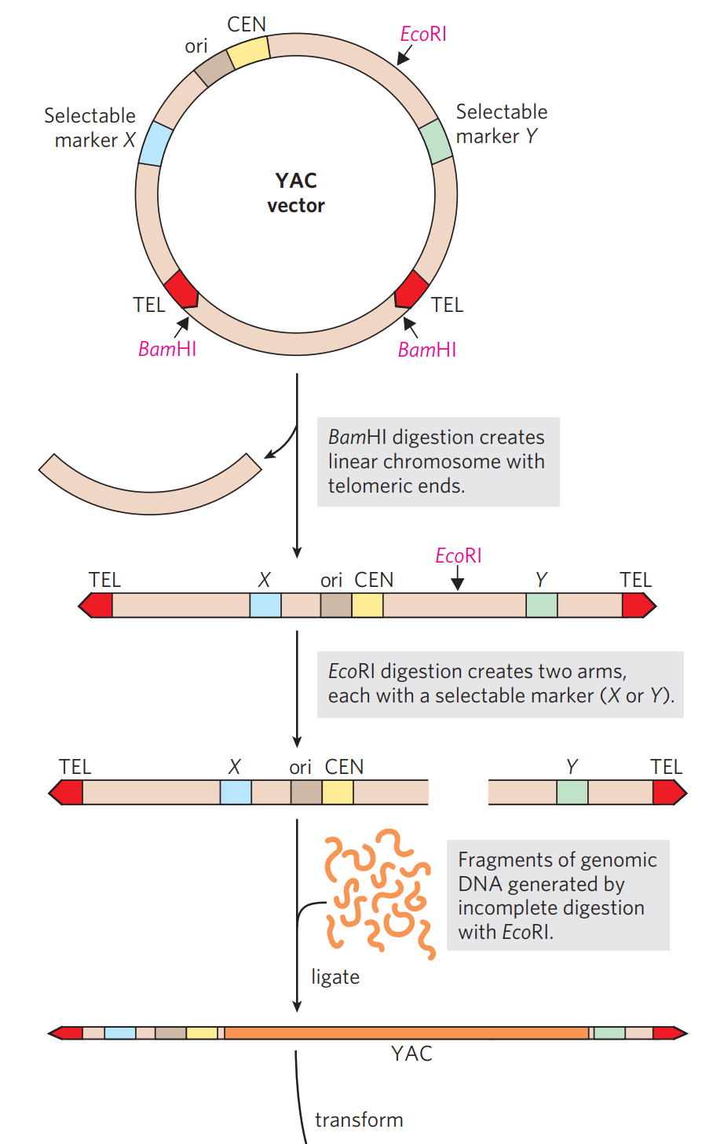
Cloning Larger Sequences
Bacterial artificial chromosome (BAC)
Stabilized by special ori genes
Yeast artificial chromosome (YAC)
Single-celled
Eukaryotic, which allows for protein folding/modification in ER/Golgi
Possess both circular and linear DNA

Slide 10
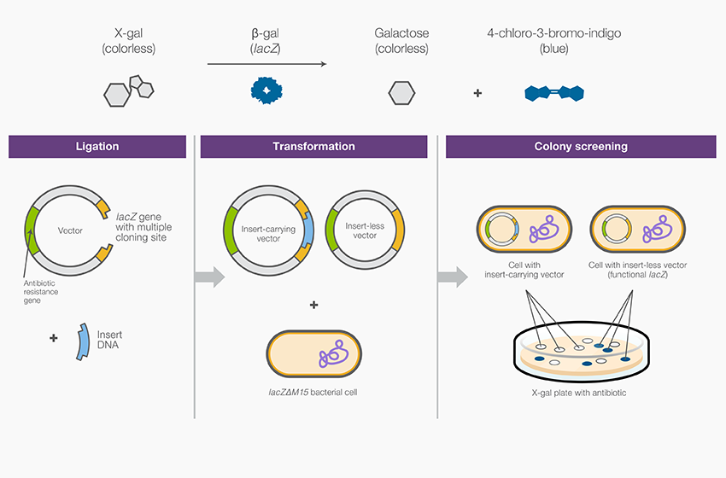
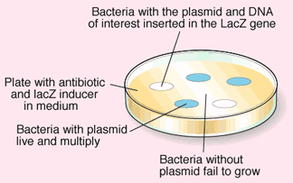
Transforming Our Bacteria
Transformation: uptake of outside DNA
CaCl₂ treatment and heat shock
Electroporation
Notes:
Transduction is taking DNA from viruses
Conjugation is exchange with other fellow bacteria

Slide 11
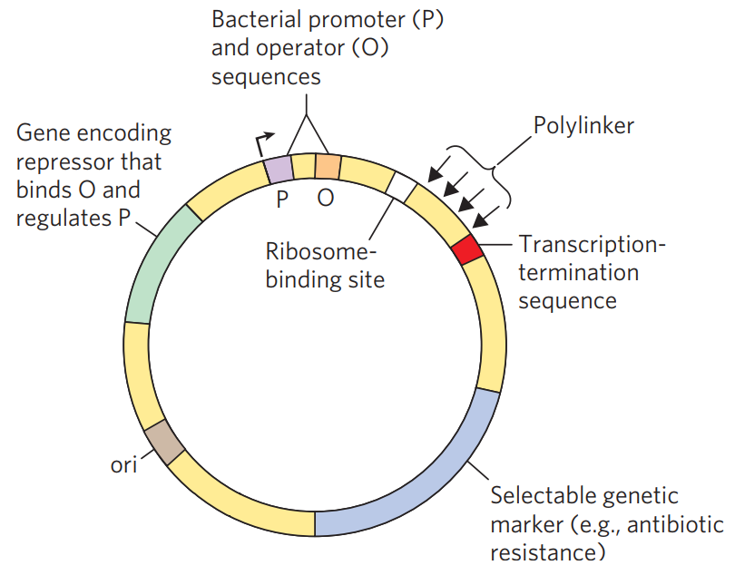
Expression Vectors (in Bacteria)
Express lots of gene product
Operon, promoter, terminator, ribosomal binding site (Shine-Dalgarno sequence)
Why eukaryotic genes may not work
Need to remove introns (cDNA)
May fold improperly, won’t have post-translational modification
Different tRNA abundances
Different chaperones
Notes:
Even if you use yeast, it won’t glycosylate some proteins the same way as humans for example.

Slide 12
Downstream Nucleic Acid Analysis Steps

Slide 13
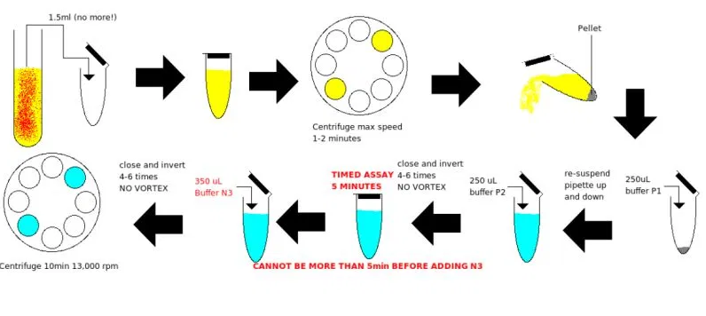
Extracting/Purifying Plasmids (Miniprep)
Keep DNA on ice between steps to prevent degradation
Follow up with ethanol precipitation and DNA quantification with spectrophotometer
Potassium acetate - neutralizes and causes flocculation of non-plasmid DNA
NaOH, detergent - lyses cells and denatures DNA
Tris-HCl, EDTA, RNAse
Notes:
I discussed ethanol precipitation in an article I wrote earlier in the year about ethanol and salting out, so check that out!
Also, there are more general ways of DNA/RNA extraction: phenol chloroform extraction, but for sake of time I didn’t include it
https://bitesizebio.com/384/the-basics-how-phenol-extraction-works/
spectrophotometer 260/280 ratio = 2.0 for RNA, 1.8 for DNA
https://www.wikiwand.com/en/Nucleic_acid_quantitation

Slide 14
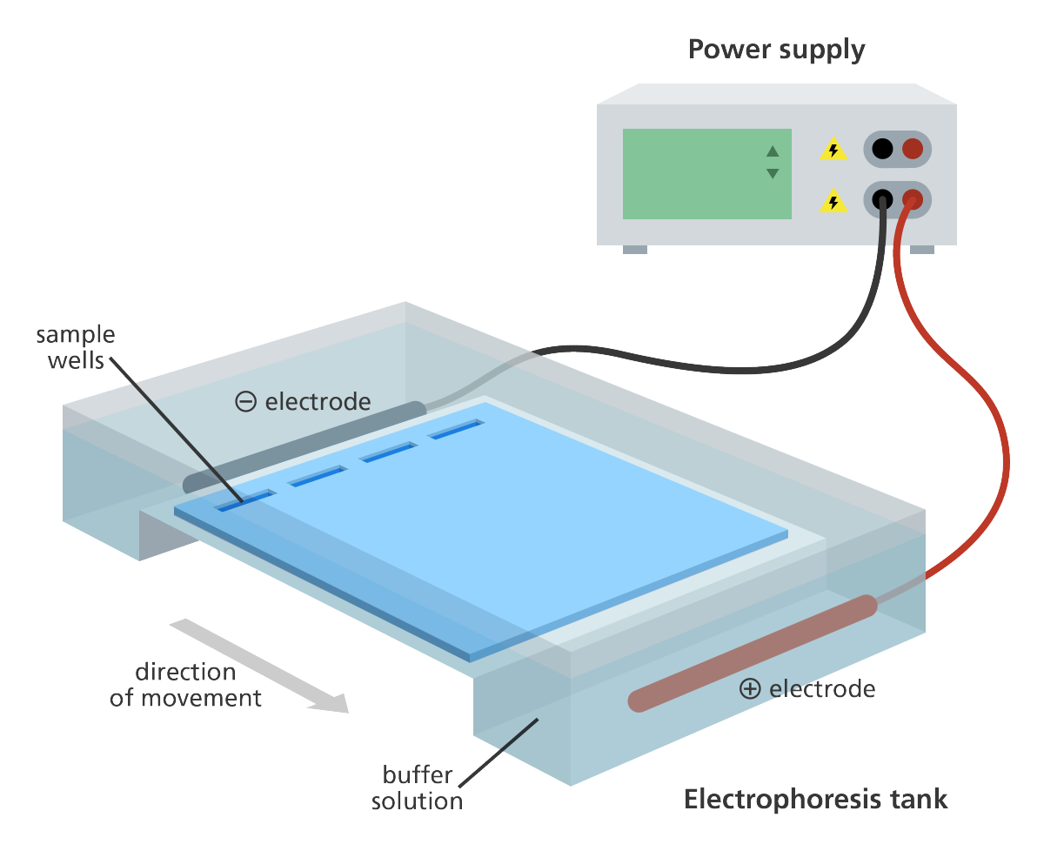
Gel Electrophoresis
Larger DNA molecules move more slowly
Gel typically uses agarose (from red algae)
Increased agarose percent helps separate smaller fragments

Slide 15
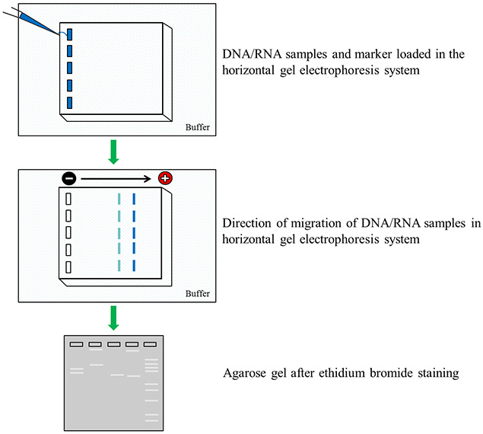
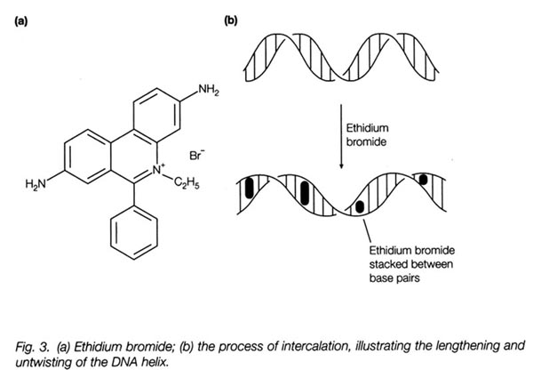
Gel Electrophoresis
Each well will have DNA sample and loading dye
Weighs it down
Dye front tells us the progress
Ethidium bromide intercalates DNA
Fluoresces under UV light

Slide 16
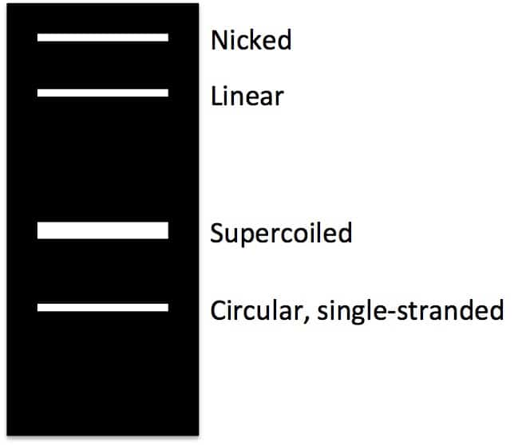
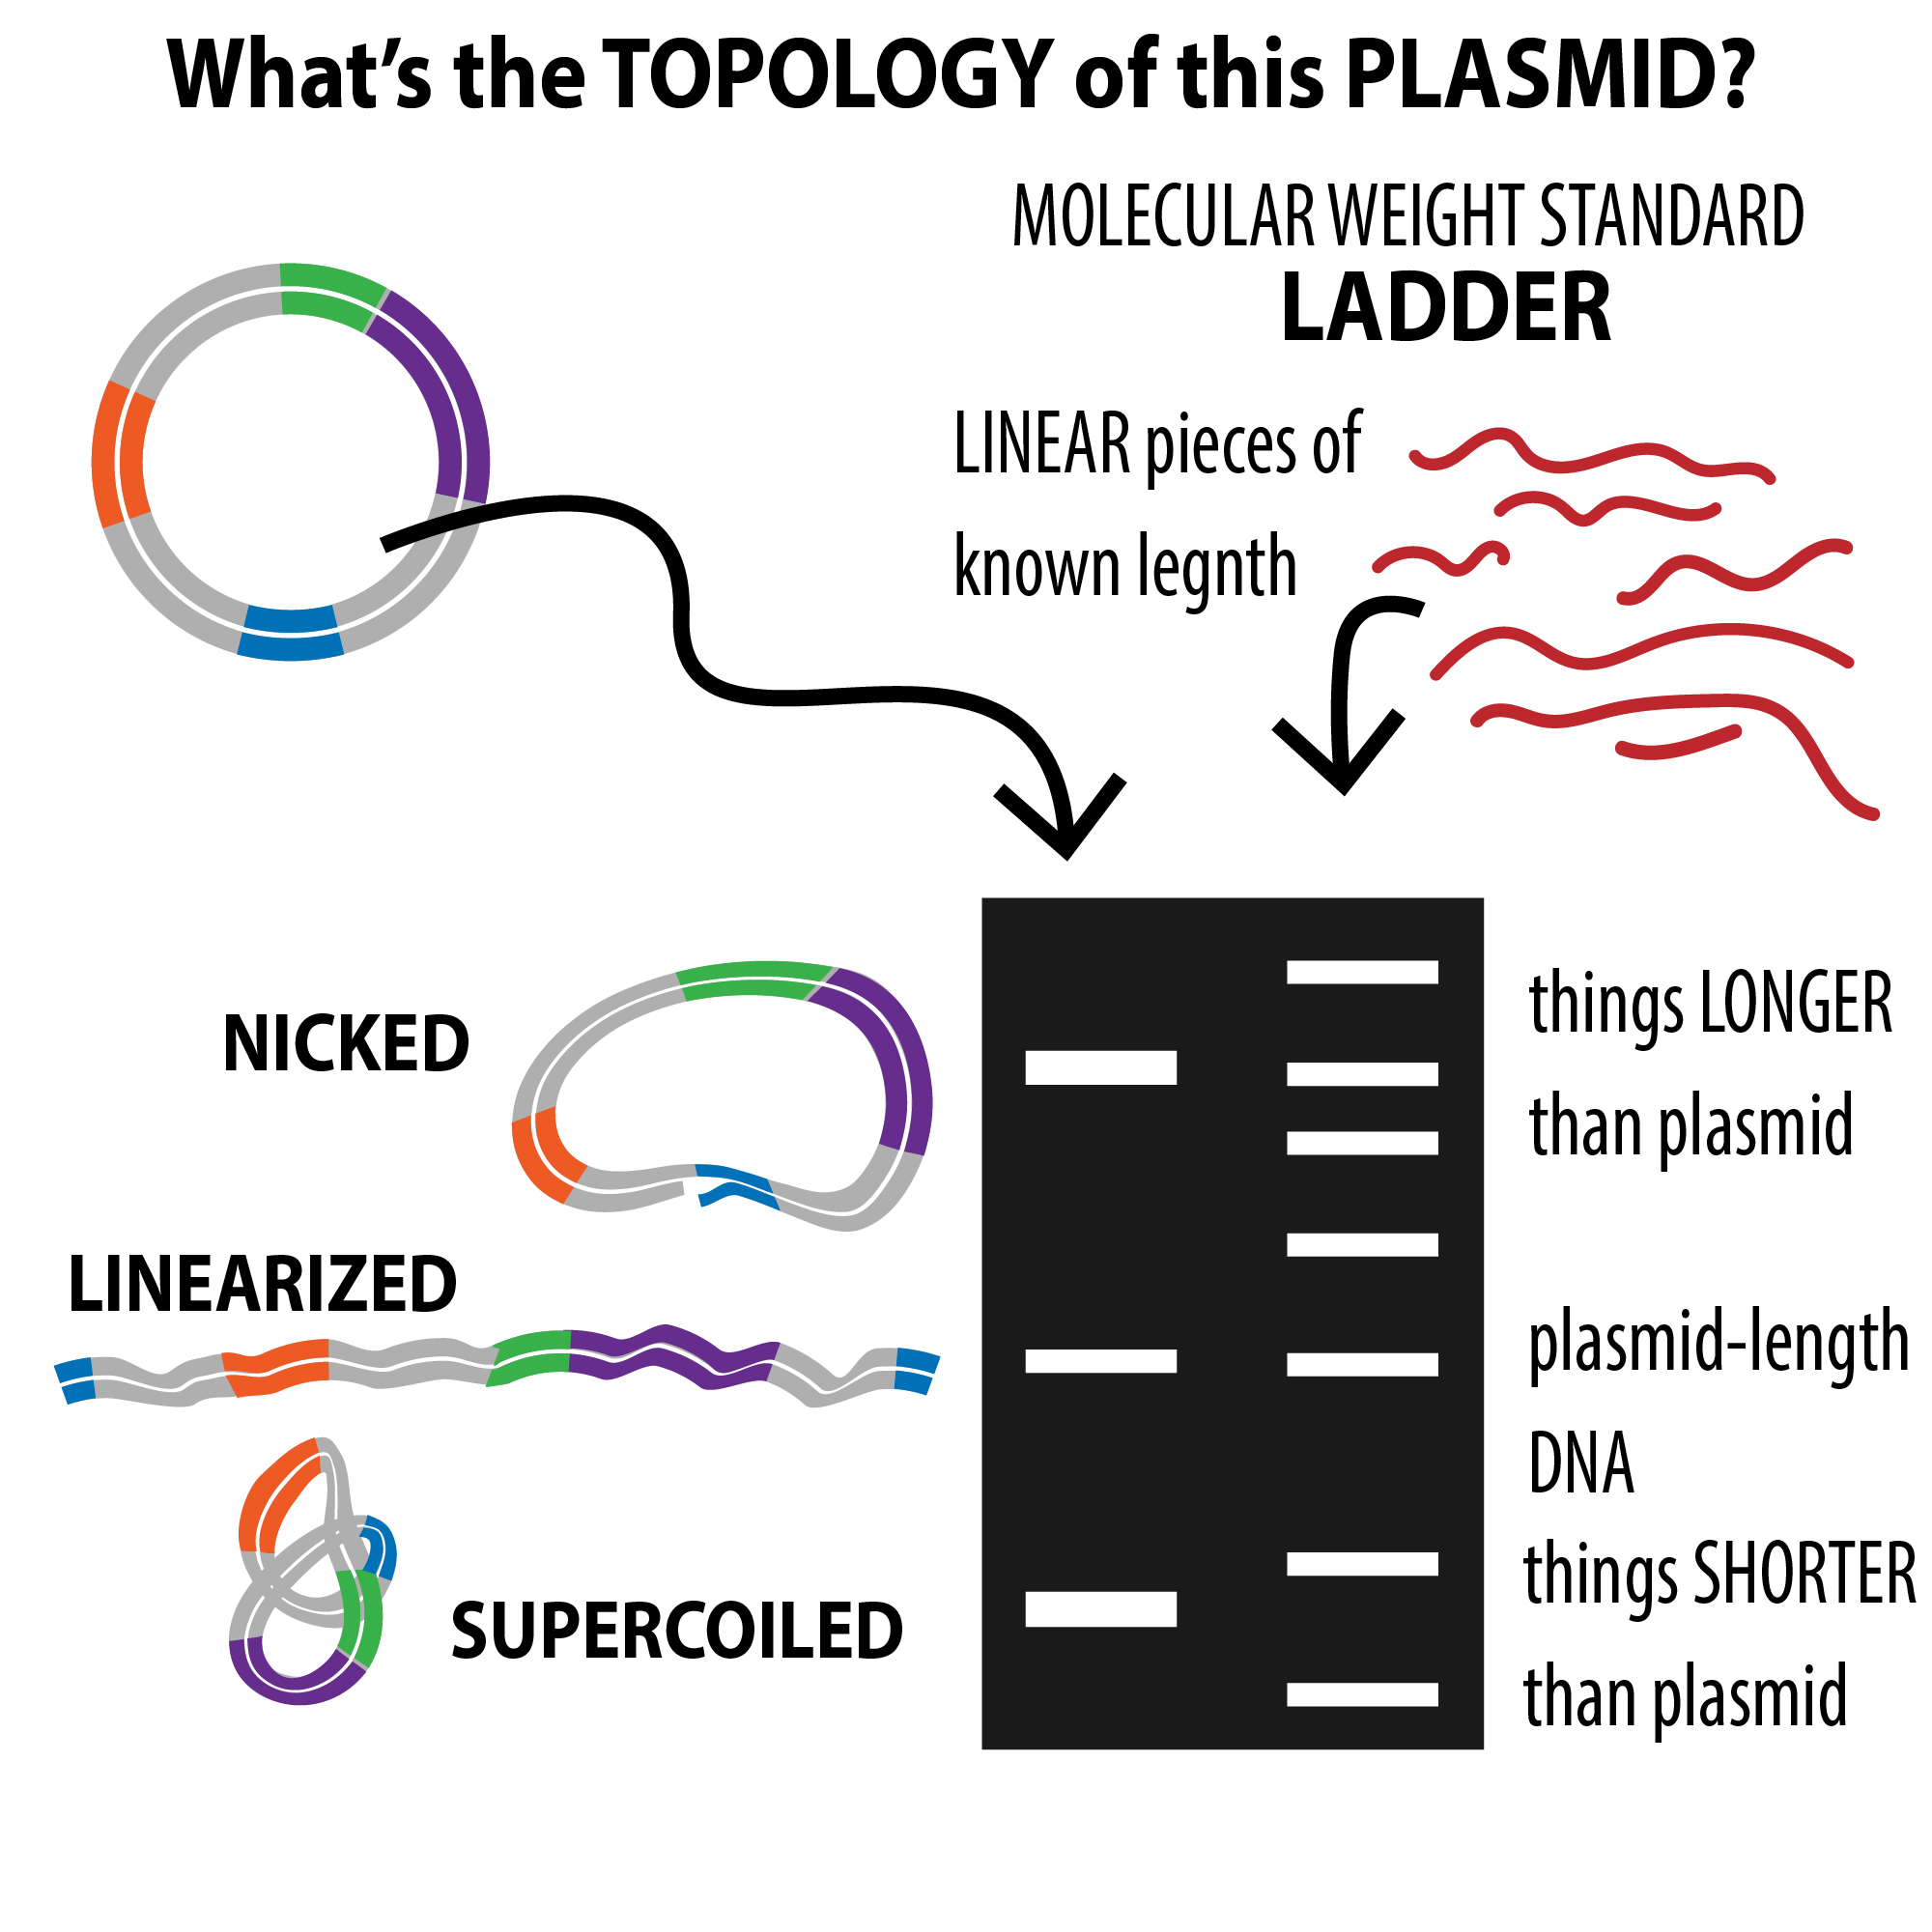
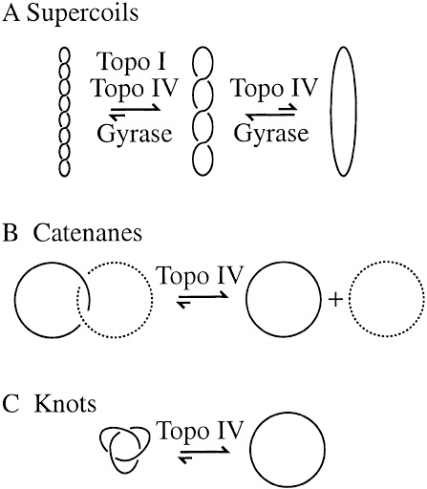
Plasmid DNA Forms
Circular - nicked, supercoiled, single-stranded
Non-circular - linear

Slide 17
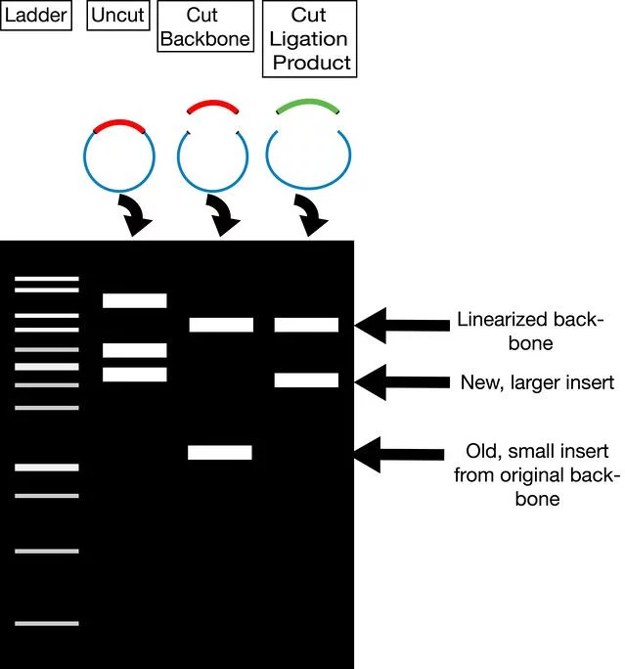
Now, back to the restriction digest
Gel visualizes different plasmid structures

Slide 18
Polymerase Chain Reaction (PCR)
4 Ingredients:
DNA sample
Forward and reverse primers
Deoxynucleoside triphosphates (dNTPs)
DNA polymerase (heat resistant)
Taq polymerase (Thermus aquaticus, thermophilic bacteria)

Slide 19
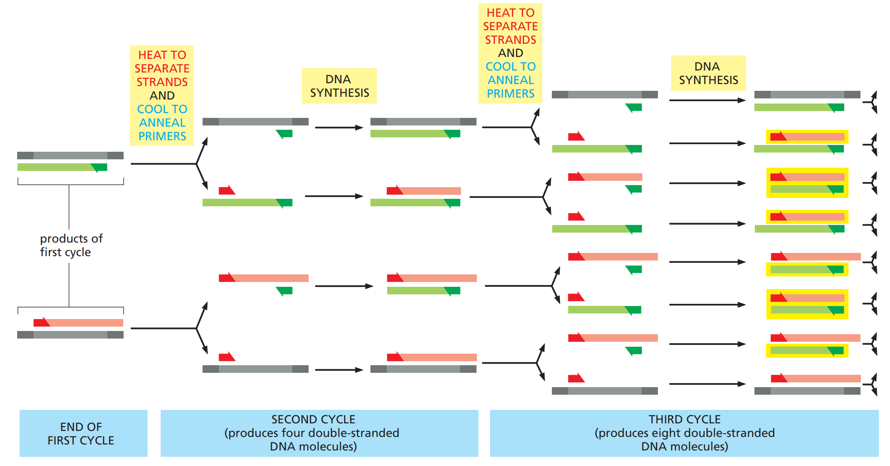
Polymerase Chain Reaction (PCR)
Denaturation (98ºC) → Reannealing (55ºC) → Extension (72ºC)
Highly sensitive
Notes:
Very interesting exercise:
See if you can construct a matrix (markov chain) that represents the transition between the number of DNA strands that are red, green, and black.
How many green, red, black will there be after 7 rounds?

Slide 20
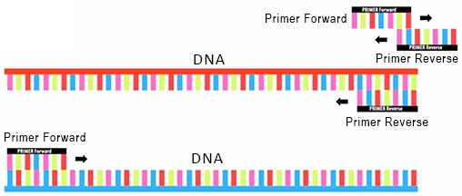
Primer design
↑Temperature ⇒ ↓Stability
↑GC content, ↑Length ⇒ ↑Stability
T_{m} - primer melting temperature, where half of all DNA duplexes are separated
↑Salt concentration ⇒ ↑Stability
Cations shield phosphate negatives charges
Avoid primer dimers
Notes:
This is an EXCELLENT explanation of base stacking - a must read!!
http://www.bio.brandeis.edu/classes/biochem104/DNA_lecture.pdf
More on base stacking
https://www.ncbi.nlm.nih.gov/pmc/articles/PMC1360284/

Slide 21
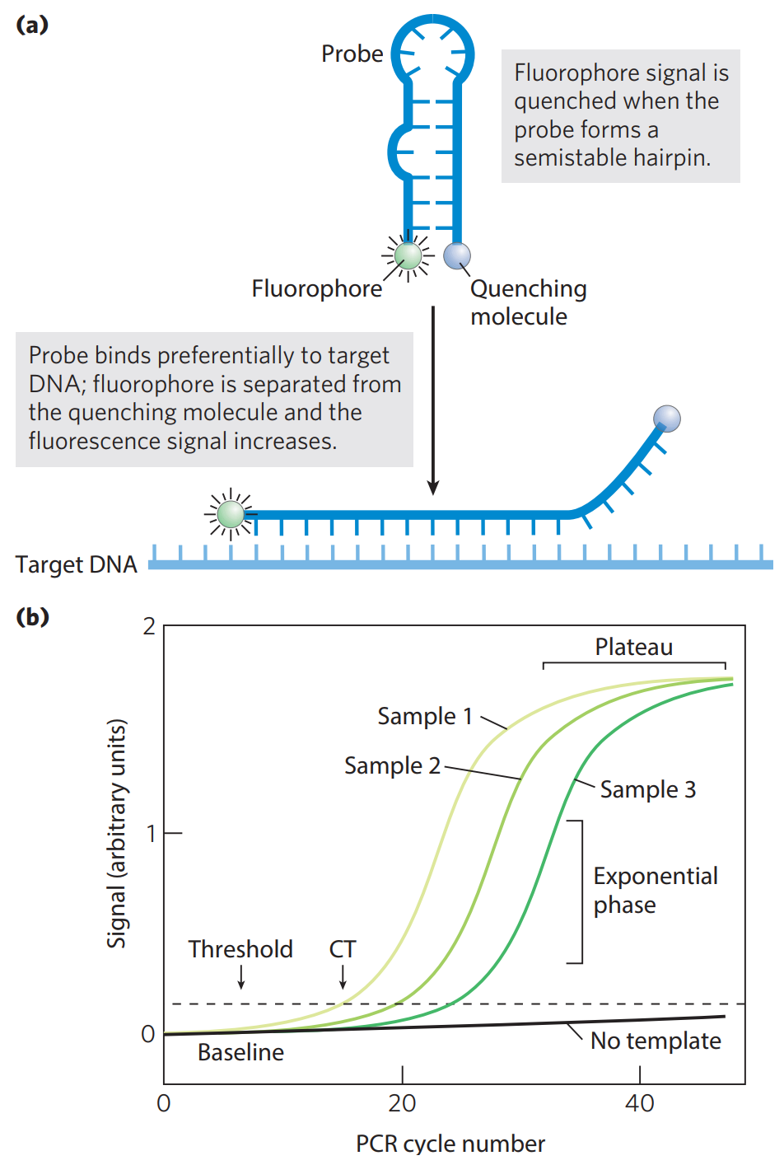
PCR Variations
Quantitative/real-time
Ct = threshold cycle value
↑DNA concentration ⇒↓Ct
Add a probe that fluoresces once hybridized to the amplified DNA

Slide 22
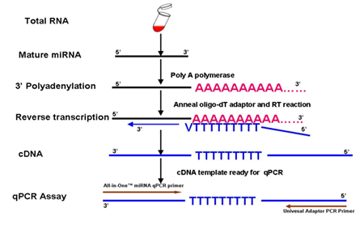
PCR Variations
 | Normal | Quantitative (or real-time)
Normal | PCR | qPCR
Reverse Transcriptase | RT-PCR | RT-qPCR
Reverse transcriptase converts RNA to DNA
Use oligo-dT primers
Follow up with normal PCR
This allows us to compare mRNA expression

Slide 23
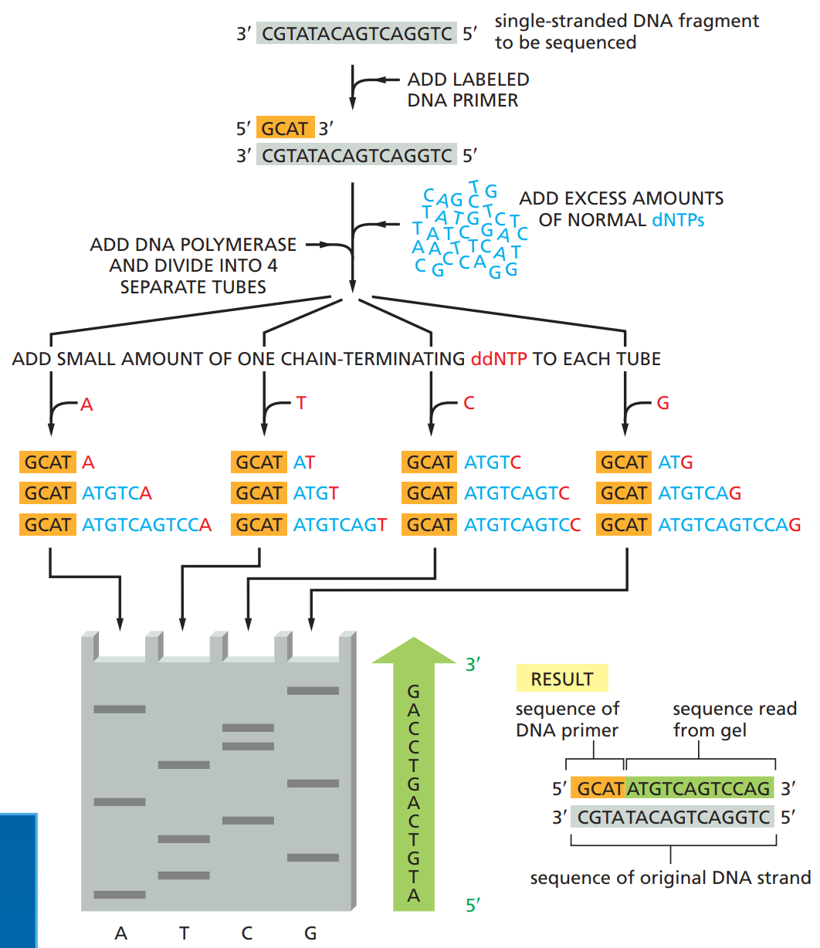
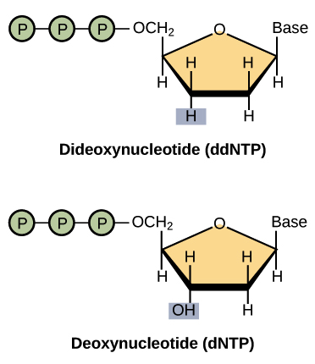
DNA Sequencing
Sanger sequencing, or dideoxy chain termination
ddNTPs lack 3’OH, so it can’t extend
All possible lengths will eventually be generated
Read from bottom-up gives complement
Can use fluorescent tags or radioactive ³²P
Notes:
Sequencing can get quite advanced, but there are good videos such as this one:
https://www.youtube.com/watch?v=fCd6B5HRaZ8

Slide 24
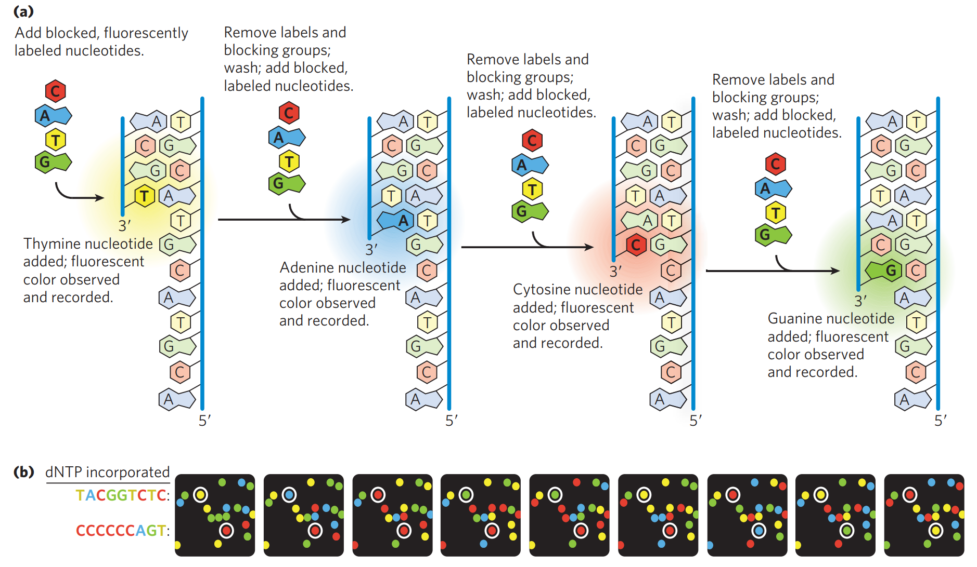
Next Generation Sequencing
Sequencing by synthesis
Massively parallel

Slide 25
Back to our Expression Vector
We now have three powerful tools (increasing specificity):
Gel electrophoresis (with restriction digest, it gives us an idea of the plasmid shape)
PCR, which can use primers to detect a sequence
DNA sequencing - expensive, overkill
PCR is typically used to confirm proper insertion

Slide 26
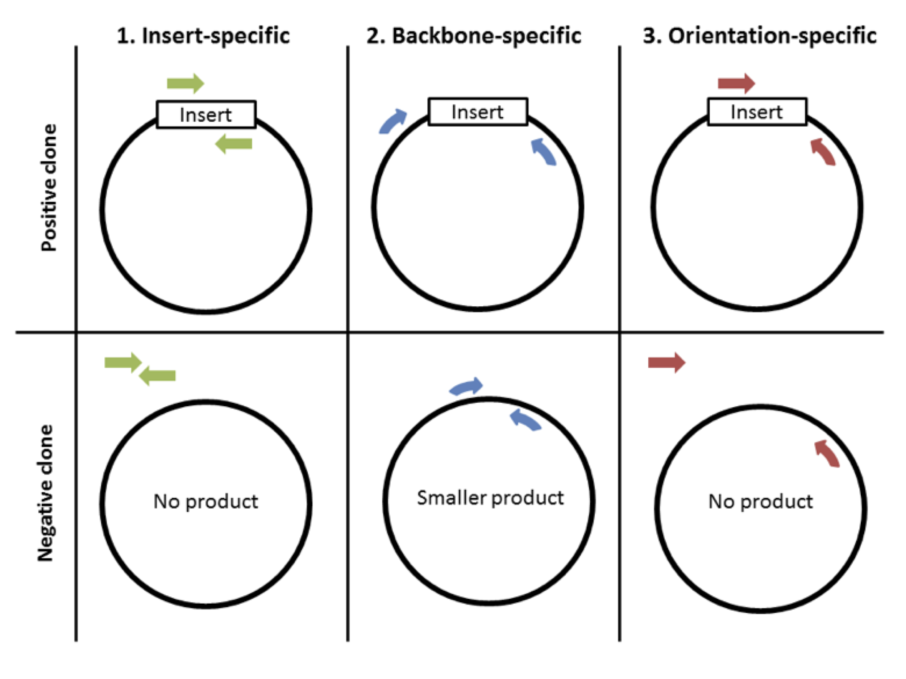
Practice!
Draw a gel showing the PCR products for each of the six cases shown
Notes:
https://blog.addgene.org/plasmids-101-how-to-verify-your-plasmid
https://blog.addgene.org/plasmids-101-colony-pcr

Slide 27
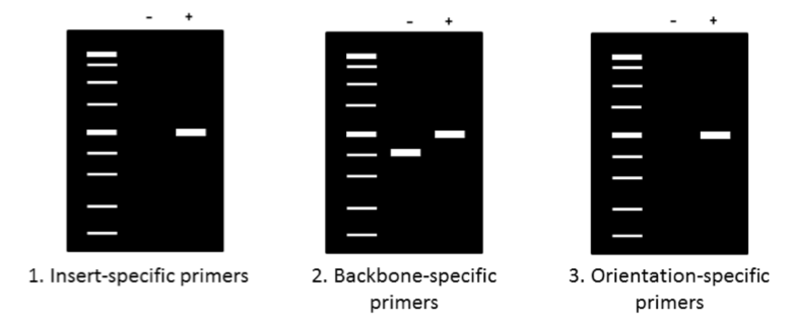
Practice!
What’s the difference between 1 and 3?
Notes:
As labeled, 3 is orientation-specific, which means it will only yield a positive result if the gene is inserted in the correct orientation. Since the whole gene is definitely not palindromic (5’ -> 3’ reads the same on top strand as bottom strand), if it is inserted in that 180º rotated orientation, the primers won’t be able to hybridize!
Notice another key fact: this distinction would only happen if we used a single restriction enzyme to insert the gene!
If we have two restriction enzymes, then there would be only ONE way for the gene to be inserted, since there is a lack of symmetry, i.e. if it were to try to enter in that 180º rotated state, it couldn’t bind to the sticky ends properly!

Slide 28
Broader Techniques for Analysis

Slide 29
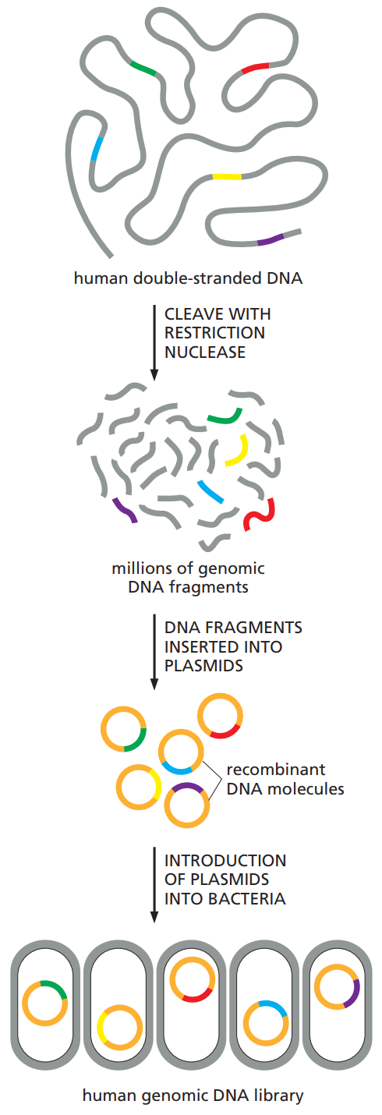
DNA Libraries
We can go back to cloning vectors, but scale it up
Fragment size can be approximately controlled
Genome library - DNA library of entire genome

Slide 30
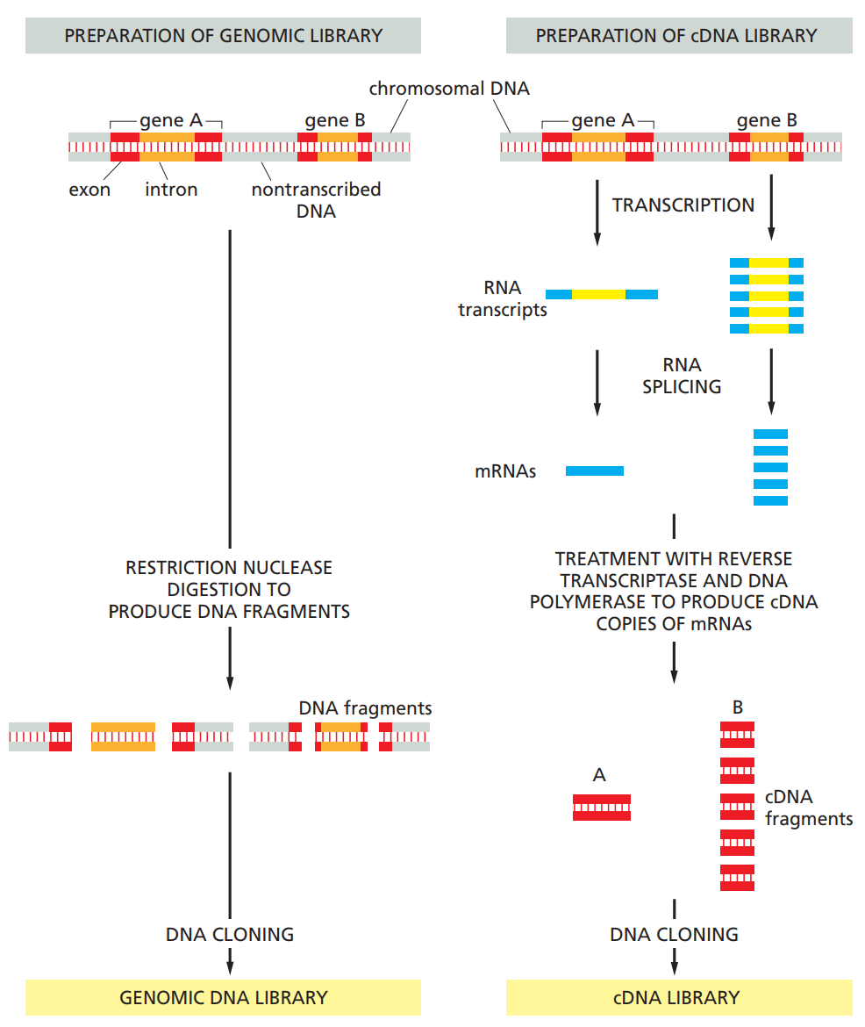
cDNA Libraries
Using reverse transcriptase, convert mRNA into complementary DNA (cDNA)

Slide 31
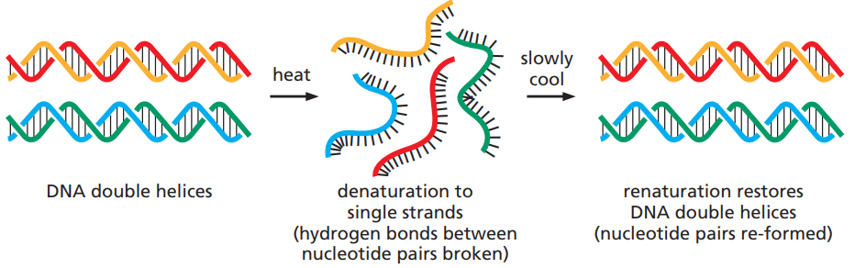
Hybridization
Take advantage of the specificity of DNA hybridization
Blotting is the transfer onto a special carrier membrane
Typical flow: Gel electrophoresis → blotting → visualization
Southern - DNA
Northern - RNA
Nitrocellulose only binds to ssDNA, so alkali denaturation step is needed

Slide 32
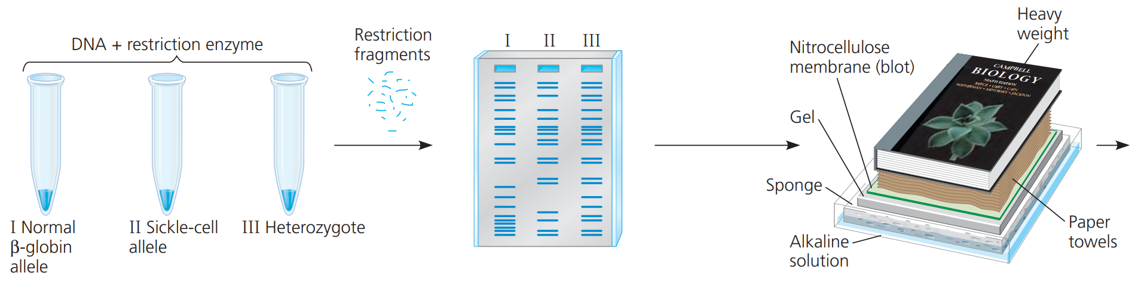
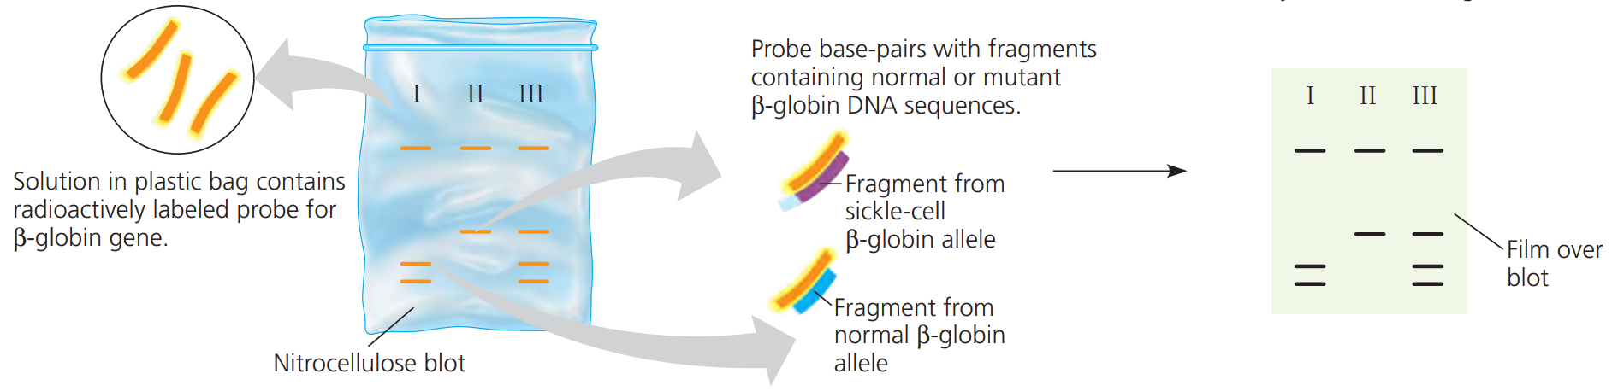
Southern Blot

Slide 33
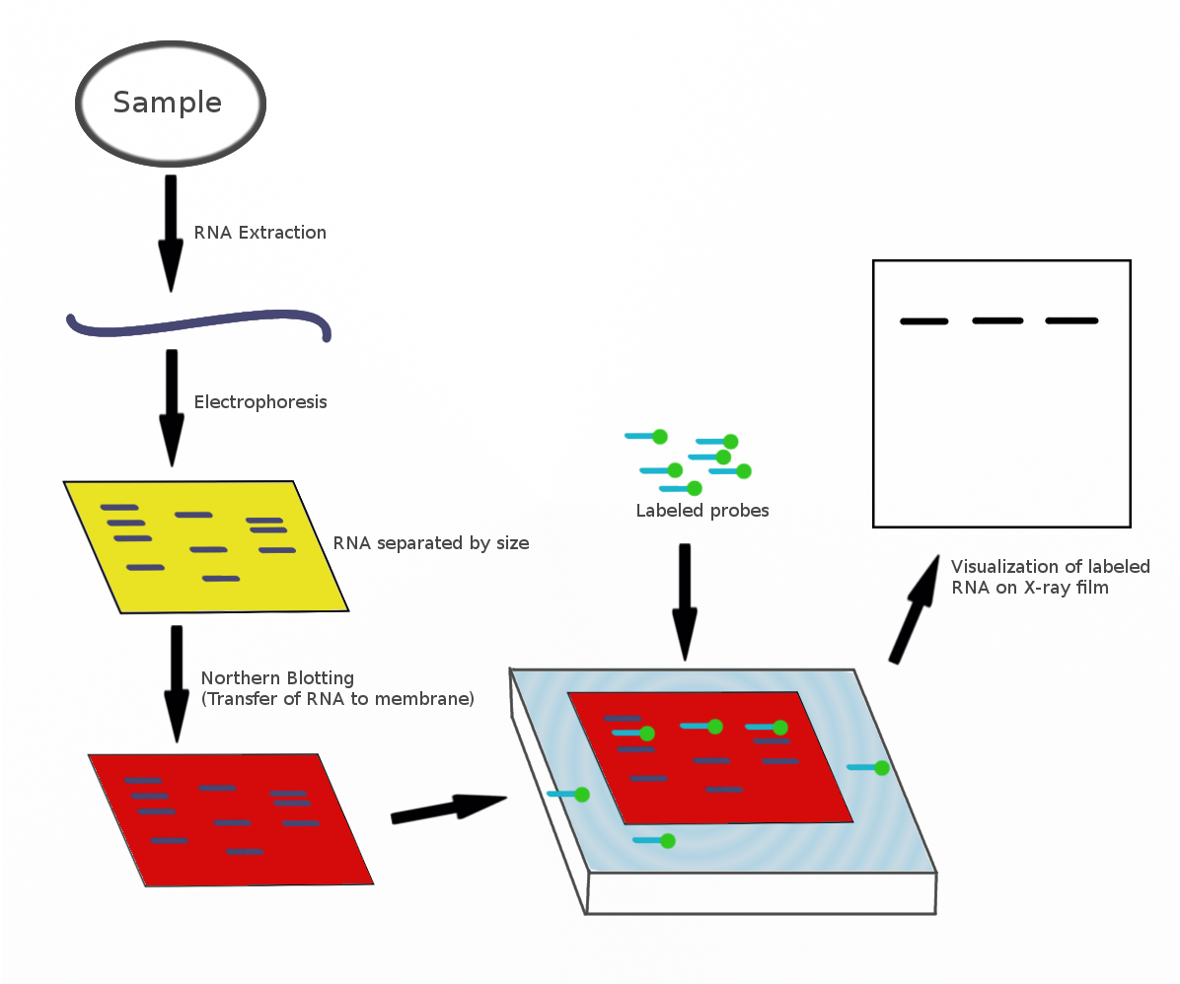
Northern Blot

Slide 34
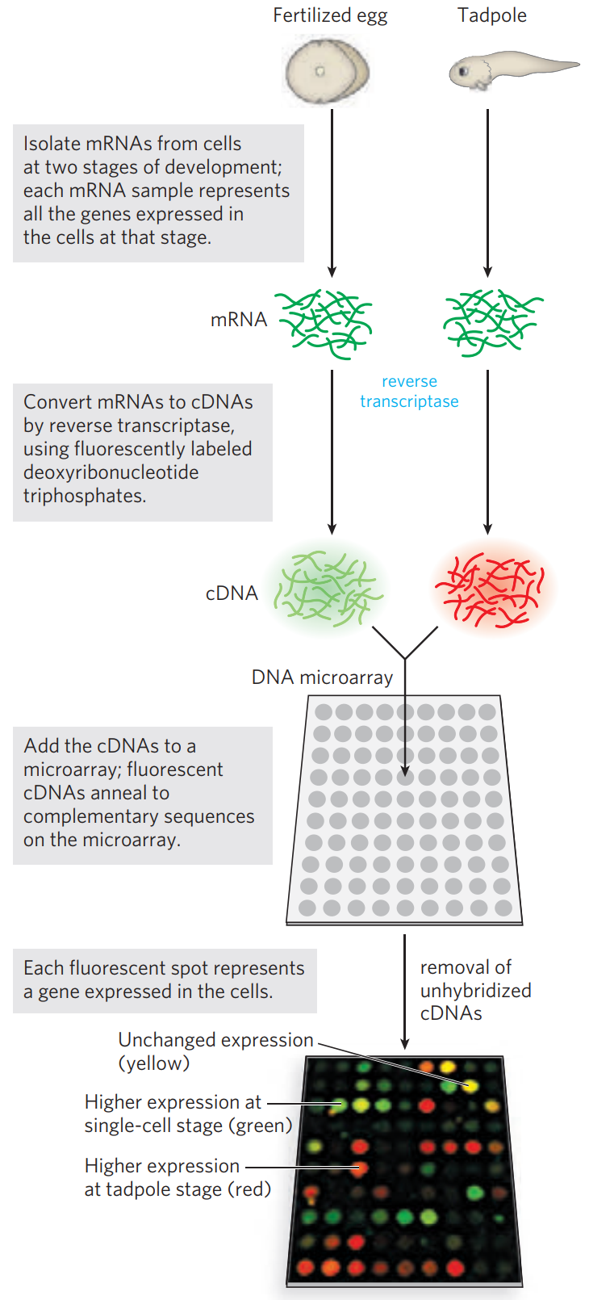
Scaling it up
Microarray analysis - snapshot of overall expression pattern
Attach probes to solid surface
Add fluorescently labeled cDNA to microarray
More comprehensive version of RT-qPCR
Notes:
Photolithography is very interesting - masks to create the wells!

Slide 35
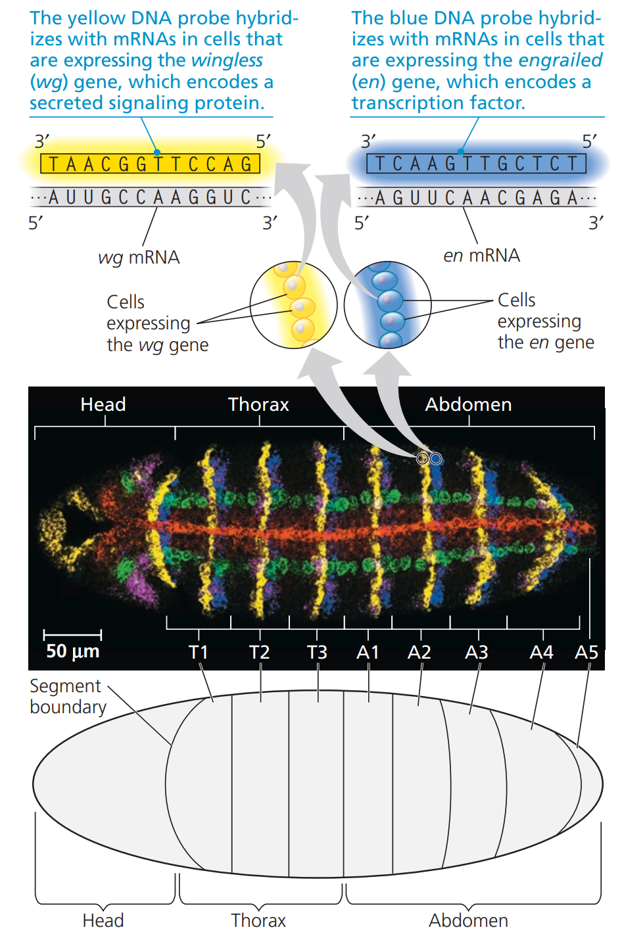
In Situ Hybridization
Further visualize patterns of expression in vivo
Add fluorescently tagged probes to embryo

Slide 36
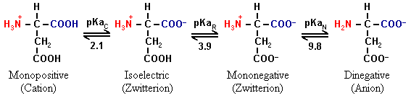
Isoelectric Point
The amino, carboxyl, and potentially the R group may be protonated/deprotonated (different from charged/uncharged!)
pH = pKa ⇒ 50% protonated, 50% deprotonated
pH > pKa ⇒ deprotonated
pH < pKa ⇒ protonated
pH = pI (isoelectric point) ⇒ whole molecule is neutral
Notes:
This is a VERY IMPORTANT concept

Slide 37
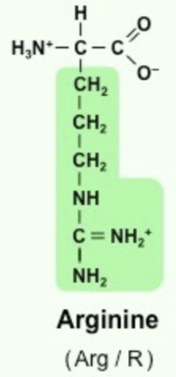
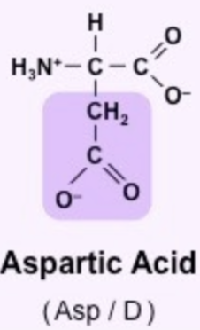
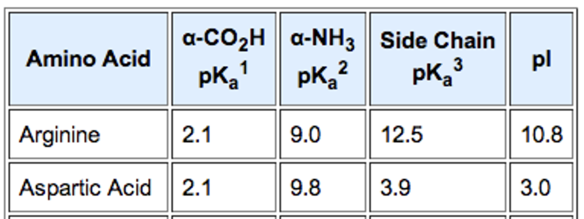
Practice!
Find the overall charge on the dipeptide: (N-terminus) Arg-Asp (C-terminus) at pH 9.5
Find the pI of the dipeptide
Notes:
Note! There will only be one carboxyl group and one amino group for the whole peptide!
So, we have 4 factors:
COOH - 2.1 = -
R(Arg) - 12.5 = +
R(Asp) - 3.9 = -
NH₃ - 9.8 = +
Charge is 0, since half are below, half above
pI = (3.9 + 9.8) / 2 = 6.85

Slide 38
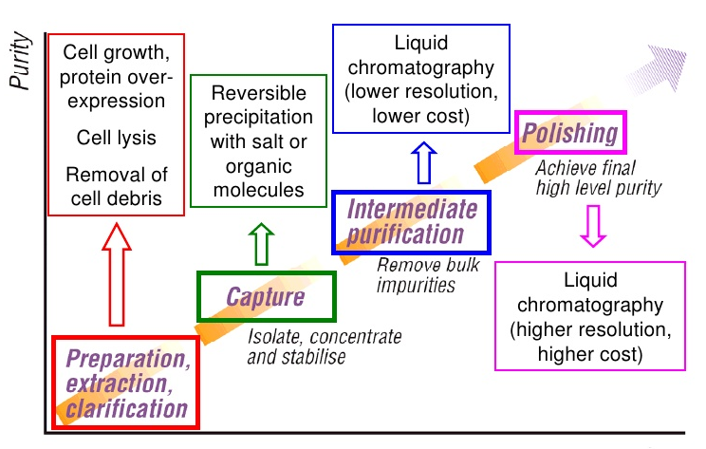
Purifying proteins
Increasingly specific techniques
Begin with ammonium sulfate precipitation
“Salting out”
Wash via dialysis
Chromatography
Gel-Filtration - size
Ion-Exchange - charge
Affinity - specific groups
High Performance Liquid Chromatography (HPLC)

Slide 39
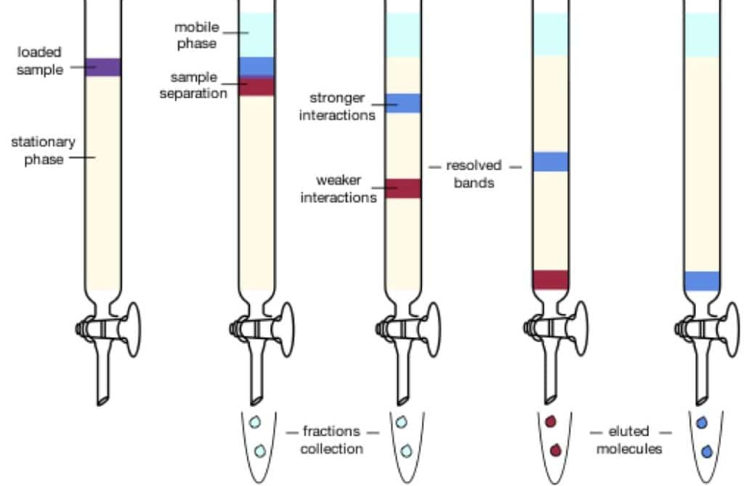
Column Chromatography Principle
Stationary phase - porous solid that interacts with sample
Mobile phase - solvent added continuously that drives flow
Fractionation (separation) due to differential levels of interaction with stationary phase

Slide 40
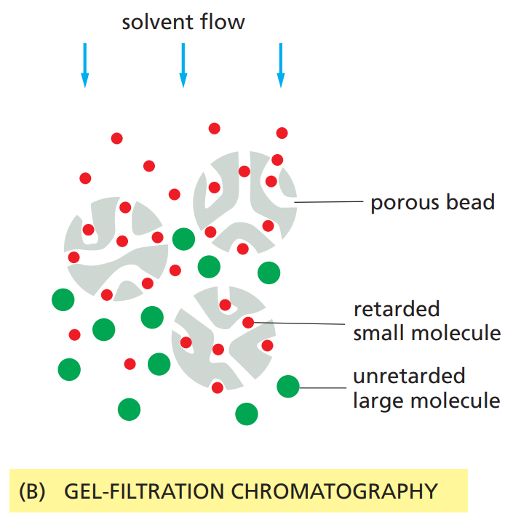
Size-Exclusion Chromatography
Also called gel-filtration
↓Size ⇒ ↑Interaction ⇒ ↓Distance
Counterintuitive - larger proteins are excluded from the interaction, eluting more quickly

Slide 41
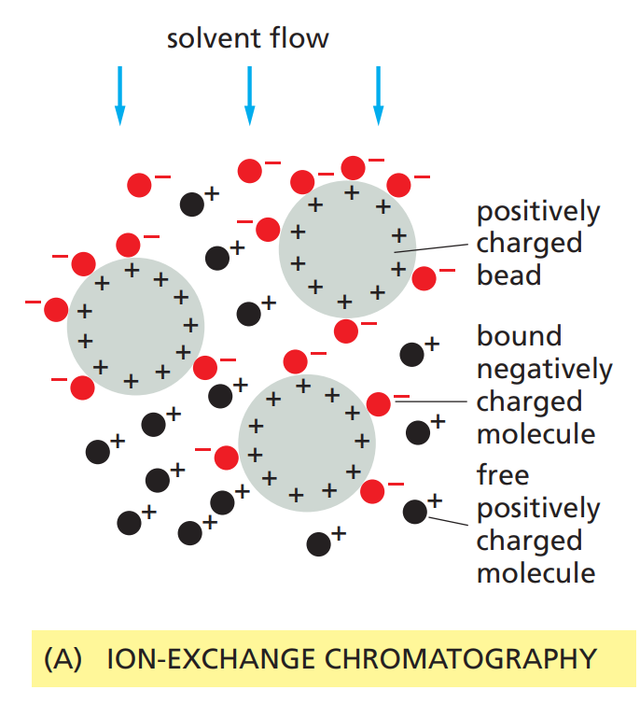
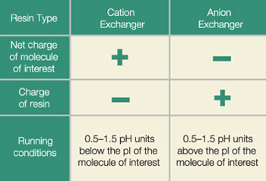
Ion-Exchange Chromatography
First, allow proteins to bind to beads with regular solvent
Elute with increasingly salty solution (displaces the proteins)
Changing pH would work too - what direction?

Slide 42
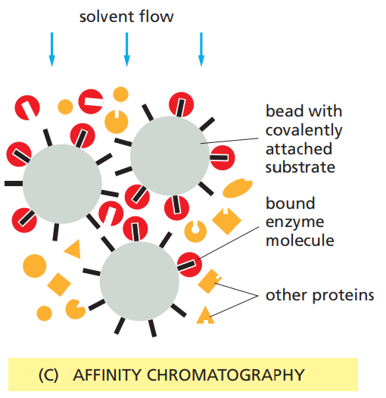
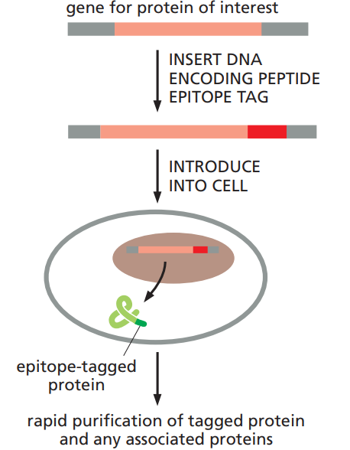
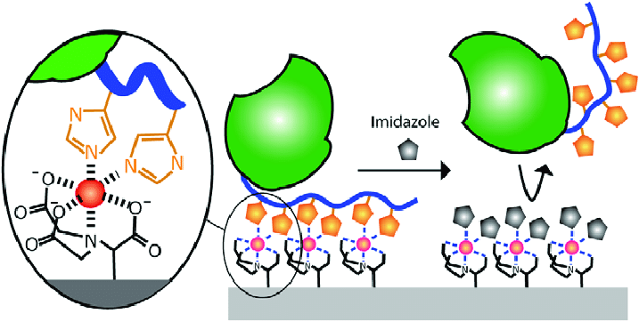
Affinity Chromatography
Genetically engineer fusion proteins
Example:
Ni²⁺ beads bind histidine-tagged proteins
Eluted with imidazole

Slide 43
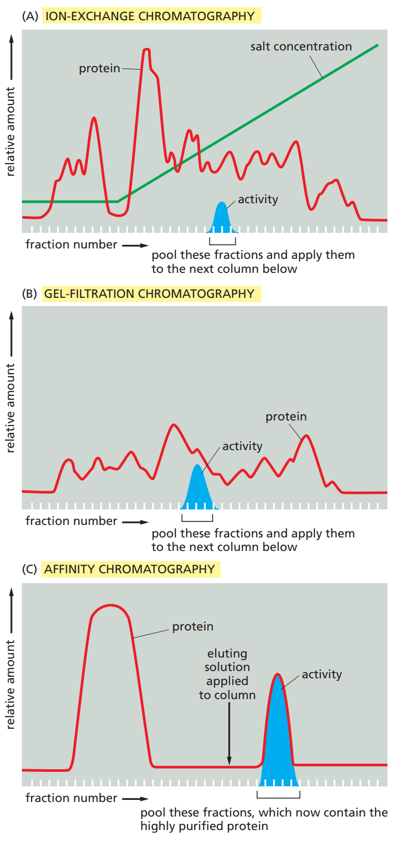
Example Data
Can use enzyme activity to select the correct fraction

Slide 44
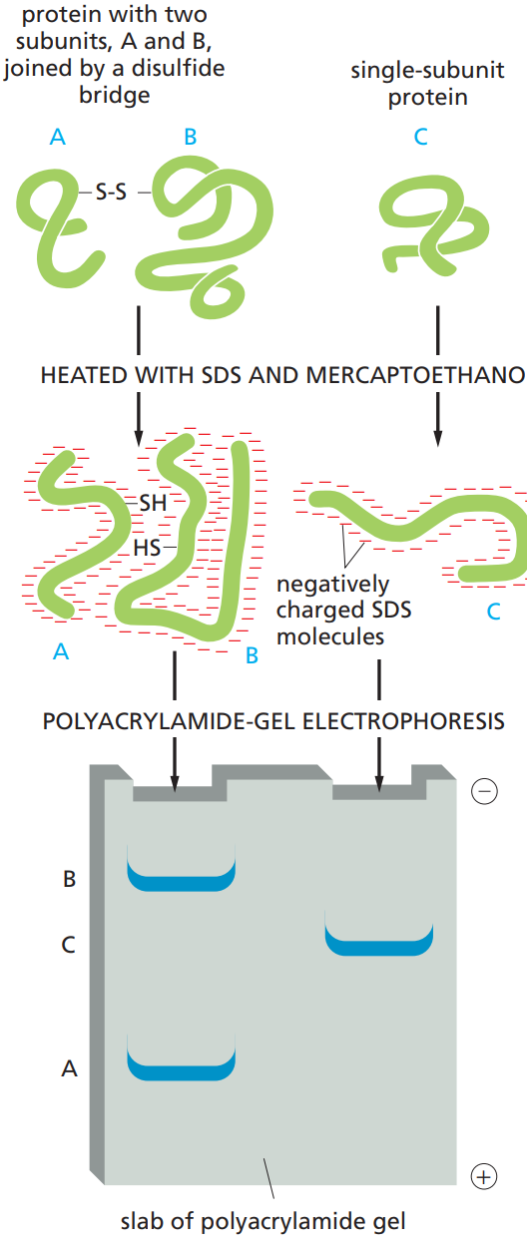



Analyzing Proteins Further:
SDS-PAGE
Polyacrylamide gel electrophoresis (PAGE)
Heat proteins to disrupt hydrogen bonds
Anionic detergent - Sodium dodecyl sulfate (SDS)
Imparts uniform charge density
Disrupts hydrophobic interaction
Reducing agents - β-mercaptoethanol or dithioerythritol
Compare to native PAGE

Slide 45

SDS-PAGE
Vertically oriented!
Discontinuous (commonly used)
Stacking gel - pH 6.8
Resolving gel - pH 8.8

Slide 46


Explaining the Discontinuous Gel

Slide 47


Isoelectric Focusing - 2D PAGE
Two-dimensional gel electrophoresis - separate first by isoelectric point, then by mass

Slide 48

Detecting Proteins - Western Blot
Follow SDS-PAGE with blotting
Flip gel, and electroblot
Add labeled antibodies to detect specific proteins
Semi-quantitative - relative
Compare with housekeeping genes
Notes:
Common housekeeping genes:
beta-actin
glyceraldehyde 3-phosphate dehydrogenase (GAPDH)

Slide 49

Antibody (Abs) Terminology
Each Ab binds to one epitope
Monoclonal
Single cell line (hybridoma)
One epitope of one antigen
Polyclonal
Population of cells
Many epitopes of one antigen
Secondary Ab binds to primary Ab’s Fc region

Slide 50

Detecting Proteins - ELISA
Enzyme-Linked Immunosorbent Assay (ELISA)
Coat plate with protein of interest
Block plate with milk protein
Horseradish peroxidase (HRP) linked to antibodies lead to colorimetric output (blue)

Slide 51

ELISA Variants
Primary antibodies are specific and expensive (typically mouse)
Secondary antibodies are polyclonal usually (goat or donkey)
Species must be different from primary
Adding secondary antibodies increases sensitivity
Notes:
More ELISA resources
https://www.bio-rad-antibodies.com/an-introduction-to-elisa.html
https://www.wikiwand.com/en/Polyclonal_antibodies

Slide 52


General Technique: Standard Curves
Perform serial dilution
Spectrophotometer
Plot absorbance vs. concentration
Interpolate values for quantitative measurements

Slide 53


ELISA Variants
HIV detection
Detect serum antibodies instead of antigen
Competitive ELISA
Higher concentration

Slide 54
DNA-Protein Interaction
DNA Footprinting
Electrophoretic Gel Mobility Shift Assay
Chromatin immunoprecipitation

Slide 55

DNA Footprinting
Proteins protect from DNase I
Sanger sequencing on parallel lanes

Slide 56

Electrophoretic Mobility Shift Assay (EMSA)
Proteins slow down DNA
Cold (unlabeled) competitors compete for protein interaction

Slide 57

Chromatin Immunoprecipitation
Formaldehyde cross-links DNA and protein
Specific IgG antibodies bind
Beads with protein A/G bind to Fc region
Many routes for downstream analysis

Slide 58

Protein-Protein Interactions
Yeast Two-Hybrid Assay
DNA-binding domain (BD/bait)
Transcription-activator domain (AD/switch)
Create fusion proteins with gene cloning
Detect interaction via reporter gene
Discover new interactions

Slide 59
Extra Topics

Slide 60

S1 Mapping - 5’ End
S1 nuclease degrades ssDNA/ssRNA
Probe extends past 5’ end of transcript
Notes:
This is pretty complicated, just know that S1 mapping helps find the exact locations of the 5’ and 3’ ends

Slide 61

S1 Mapping - 3’ End
S1 nuclease degrades ssDNA/ssRNA
Probe extends past 3’ end of transcript

Slide 62

Primer Extension
Labeled primer extended by reverse transcriptase
Only maps the 5’ position of transcript
More precise than S1 mapping
Couple with Sanger sequencing

Slide 63

STR Analysis
STR/SSR/microsatellites - short tandem repeats or simple sequence repeats
VNTR/minisatellites - variable number tandem repeats

Slide 64

RFLP Analysis
Restriction fragment length polymorphism analysis
Caused by SNPs - small nucleotide polymorphisms

